Slide 1
Builder Pattern Humayun Ahmed Principal Software Engineer Cefalo School

Slide 2
Builder Pattern
Separate the construction of a complex object from its representation so that the same construction process can create different representations.

Slide 3
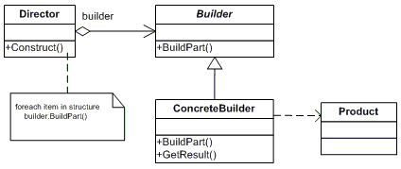
Builder Pattern

Slide 4
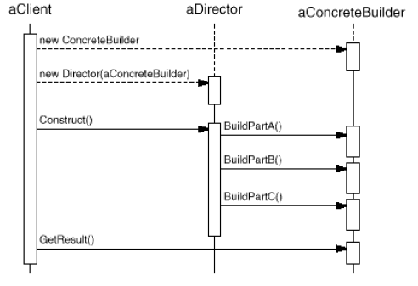
Collaboration

Slide 5
Homework
Suppose you are building an architecture tool. Your tool can draw Walls, Doors, Windows, Floors, Rooms. Now you want to give user a few standard house templates which they can pick and start modifying.
Use Builder Pattern to create Buildings for such templates.
Clue: IBuildingBuilder, ISingleStoryBuilder, IMultiStoryBuilder, ConcreteBrickHouseBuilder, ConcreteGlassHouseBuilder
IBuildingDirector, ThreeStoryBuildingDirector, DuplexDirector, GardenHouseDirector

